Slide 1
Foreign Investment Analysis
Swapnil Gavali

Slide 2
Objective
Analyze Foreign Direct Investment (FDI) trends in India from 2000-01 to 2016-17.
Conduct sector-wise and year-wise investment analysis.
Identify key metrics and factors influencing FDI inflows.
Establish meaningful relationships between different attributes of the dataset.
Provide insights for stakeholders, policymakers, and investors to make informed decisions regarding FDI in India.

Slide 3
Benefits
Informed decision-making for stakeholders.
Mitigation of investment risks through insights.
Support for policymaking and strategy formulation.
Sector-specific performance analysis.
Forecasting potential trends.
Enhancing transparency and accountability.
Contributing to knowledge generation in FDI analytics.

Slide 4
Key Insights
Total Investments 332 K
Highest Investment 8.6 K
Total Sectors 63
Total Categories
16
Top Investment Sector
Services Sector

Slide 5
Total Investments by year
In 2016, the sum of investments reached 43,478.26, marking the highest total investment among all years analyzed.
This amount was notably 1,887.26% higher than the sum of investments in 2003, which stood at 2,187.85, representing the lowest total investment.
2016 accounted for 13.10% of the total sum of investments across all 17 years.
The range of sum of investments across the entire 17-year period varied significantly, spanning from 2,187.85 to 43,478.26.

Slide 6
Investments by Category
Consultancy and Professional Services sector received the highest sum of investments at $63,094.22.
Electronics and Technology sector followed closely with $50,598.39 in investments.
Diverse range of sectors attracted investments, including Engineering and Machinery, Chemical and Allied Industries, Heavy Industries, and Miscellaneous Services.
Sectors like Engineering and Machinery, Chemical and Allied Industries, and Heavy Industries are significant recipients of investments, reflecting their importance in the economy.
Sectors such as Defense Industries and Education and Training received comparatively minimal investments, indicating potential areas for improvement in investment allocation strategies.

Slide 7
Investments by Category and Year
The year 2016 saw significant investments in Electronics and Technology ($9376.03) and Consultancy and Professional Services ($8945.21), indicating their attractiveness to investors.
In 2011, the Chemical and Allied Industries sector received substantial investments amounting to $7941.44, reflecting investor confidence in this sector during that period.
Across multiple years, there is a consistent pattern of investments in sectors such as Electronics and Technology, Consultancy and Professional Services, and Miscellaneous Services, suggesting their sustained appeal to investors.
Sectors like Engineering and Machinery, although receiving investments across different years, show variations in investment levels, indicating potential fluctuations in investor interest or market conditions.

Slide 8
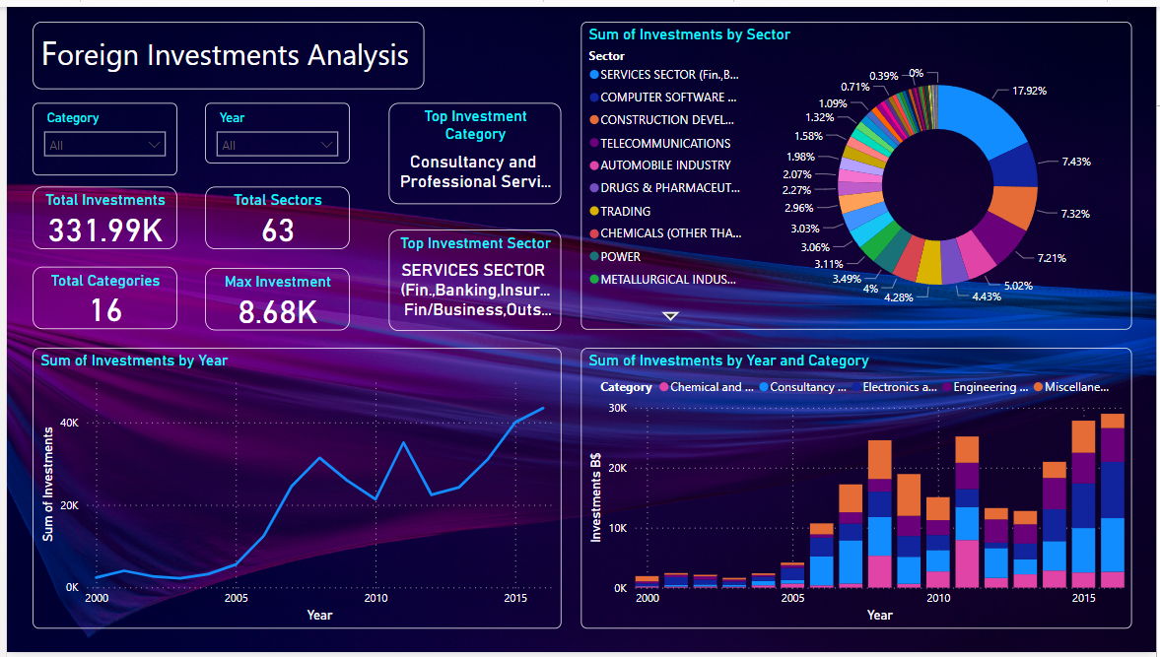
My Power BI Dashboard

Slide 9
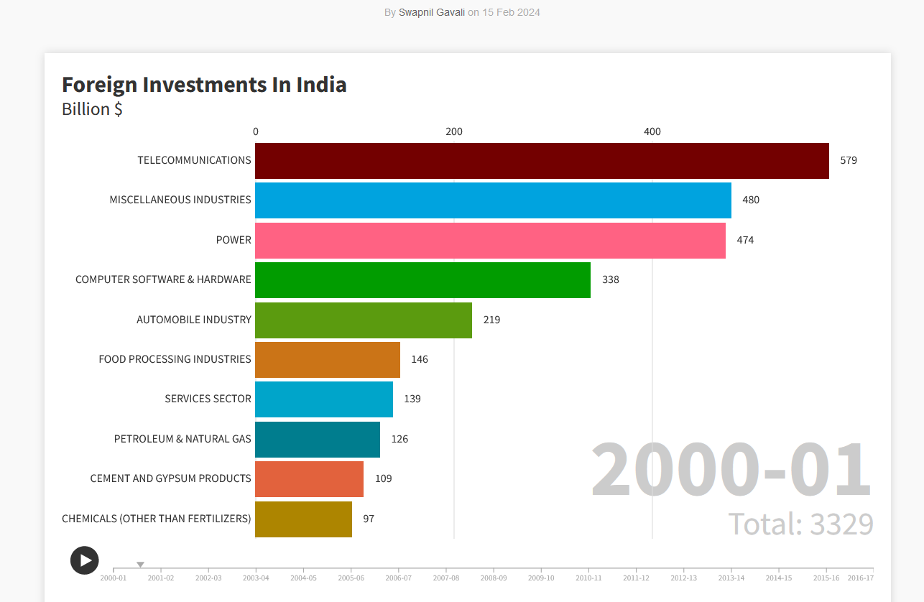
Flourish Visualization By year

Slide 10
Conclusion
The analysis highlights the attractiveness of sectors such as Electronics and Technology, Consultancy and Professional Services, and Chemical and Allied Industries to investors, with significant investments observed in certain years.
Despite fluctuations in investment levels across different sectors and years, there is a consistent pattern of sustained appeal for sectors like Electronics and Technology, Consultancy and Professional Services, and Miscellaneous Services.
Sectors such as Engineering and Machinery, Chemical and Allied Industries, and Heavy Industries emerge as significant recipients of investments, underscoring their importance in driving economic growth and development.
The disparity in investments among sectors like Defense Industries and Education and Training suggests potential areas for improvement in investment allocation strategies to foster growth and innovation in these sectors.
The substantial increase in total investments in 2016 compared to previous years underscores the dynamic nature of investment trends, emphasizing the need for continuous monitoring and adaptation of investment strategies to capitalize on emerging opportunities in the market.

